Slide 1
Utilizing Data Mining and Machine Learning to Combat Cyber Threats
Created By: Shaunelle Riley

Slide 2
Introduction
Phishing attacks continue to pose a significant threat to cybersecurity, targeting individuals, organizations, and even governments worldwide.
Attacks typically involve malicious attackers attempting to deceive users into giving up sensitive information such as login credentials, financial details, or personal data by impersonating trustworthy individuals through emails, websites, or other communication channels. emails, websites, or other communication channels
Detecting phishing URLs is crucial for reducing security risks and protecting users from falling victim to these scams.
This project will try to develop an advanced machine learning framework which is capable of distinguishing between malicious and benign URLS.

Slide 3
Problem Statement
Cyber criminals relentlessly target users' personal data through phishing attacks, making it one of the widespread and damaging threats today. These attacks can cost individuals and organizations billions annually. Phishing is especially harmful as it exploits human vulnerability by impersonating trusted entities. This issue is particularly critical because it disproportionality affects society’s most vulnerable groups.

Slide 4
Solution Statement
This project seeks to solve this problem by developing of a comprehensive solution to identify and categorize URLS as either benign or malicious. Using Python code two different models using two different algorithms were created to detect phishing URLS. The algorithms used were XGBoost and Random Forest.

Slide 5


Results
Data
Preprocessing
Exploratory Analysis
Data Mining
Results

Slide 6
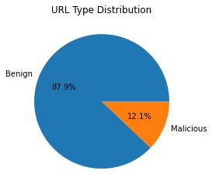
Data
The dataset was taken from Christian Urcuqui’s profile on Kaggle.
It consists of 1781 unique URLs.
1565 benign
265 malicious
The dimensions of the dataset include information about the URL itself as well as information about the application layer and network traffic which was collected.
This information was collected from a low interaction honeypot as well as the WHOis database.

Slide 7
Preprocessing
Multiple steps were taken to preprocess the data. This was done to ensure that the data was uniformed and valid, so that the results received from the models would be accurate.
The steps taken were:
Dimensionality reduction
Formatting for uniformed data
Handling Null Values
Reduction of attribute values for categorical data
Separating numerical and non-numerical data and creating labels for categorical data for numerical data
Rescaling of data

Slide 8
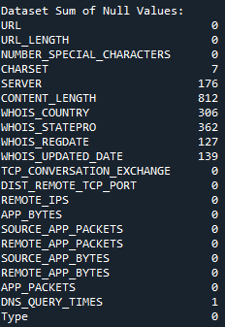
Dimension reduction
Removing URL, WHOIS_REGDATE and WHOIS_UPDATED_DATE because they consist of strings and date datatypes which are not being utilized in this project.
Removing CONTENT_LENGTH due to high null count

Slide 9
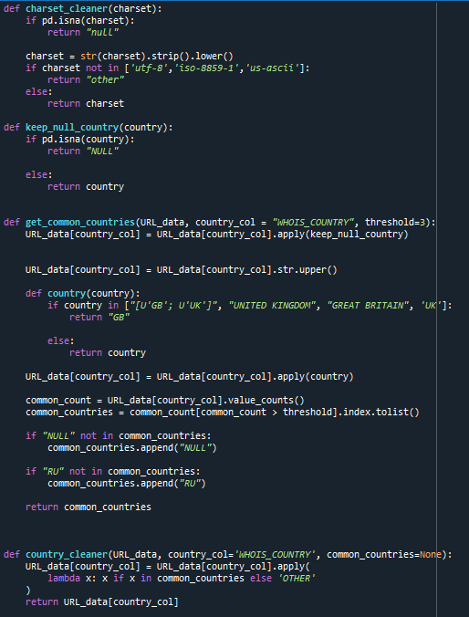
Formatting for uniformed data
Handling null values
Reduction of attribute values for categorical data

Slide 10
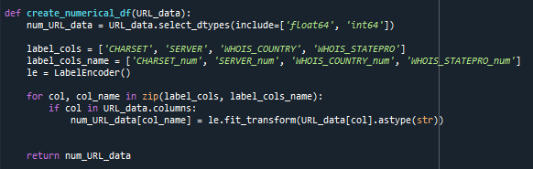
Creating Numerical dataFrame Including labels for categorical data

Slide 11
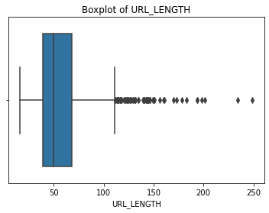
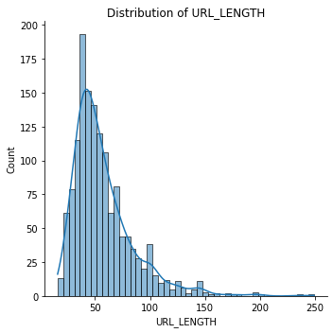
Outlier Analysis
Outlier Analysis was conducted but due to the heavily skewed nature of the data no values were removed.
This approach was also taken as there were no datapoints which could be verified as inaccurate.

Slide 12
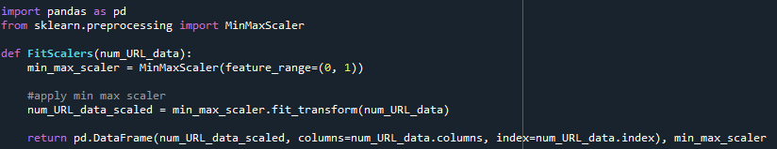
Rescaling of Data

Slide 13
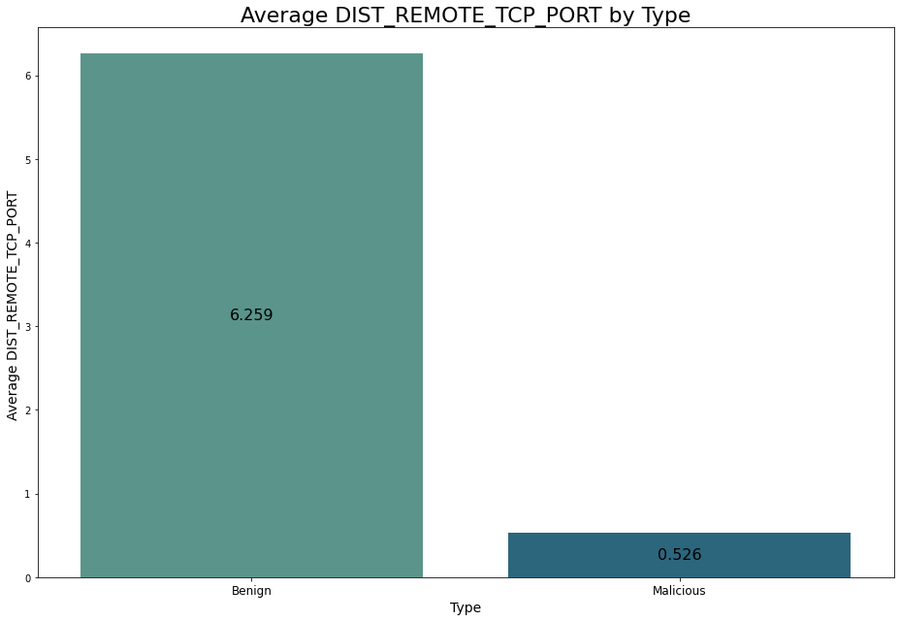
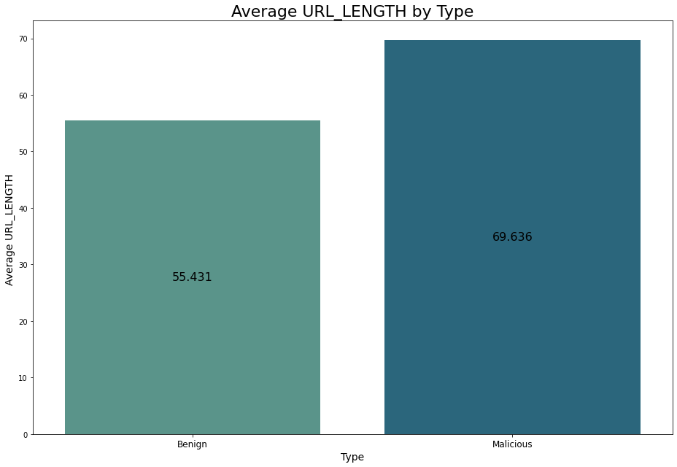
Exploratory Analysis
Exploratory Analysis was conducted to find any trends among the data, as well as the correlation among the dataset. Below are a few images which highlighted the trend in some columns.

Slide 14
Data mining
Two different machine learning algorithms were trained and tested using the dataset. These algorithms were:
XGBoost
Random Forest
The algorithms were trained and tested on 1780 data points after preprocessing.
1564 benign URLs
216 malicious URLs
The dataset was randomly split into an 80% training size and 20% test size but the target variable retained its category proportions as stratify=y was utilized.
The y training data included 1250 benign URLs and 173 malicious URLs.
The y testing data included 314 benign URLs and 43 malicious URLs.
The independent variable (X) included but is not limited to the URL length, number of special characters, country and state of server location and the number of packets received from the server.
The dependent variable was whether the URL was phishing.

Slide 15
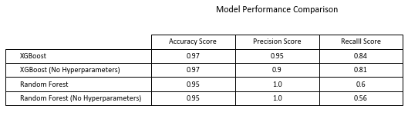
HyperParameters
XGBoost and Random Forest were specifically chosen for this dataset as they handle noisy, imbalanced and high dimensional data very well. This was proven to be true as they both performed well without hyperparameters.
Hyperparameters, Hyperparameter tuning, and threshold tuning were still extremely useful in increasing some metrics as can be seen below.

Slide 16
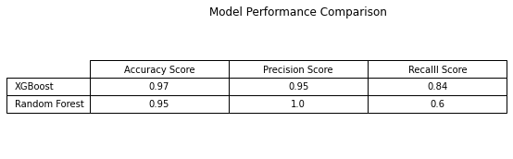
Results
The models were compared on their accuracy, precision, and recall based on the test values. The following scores were received.

Slide 17
Limitations
The data is subject to limitations due to the small dataset size.
Due to its size, it may limit the model’s ability to generalize to unseen data and could potentially lead to overfitting or underfitting models.

Slide 18
Conclusion
Through these rigorous preprocessing steps, the model extracts key characteristics from URLs, allowing it to make informative predictions with high accuracy.
From the results received from the models I would say that the XGBoost is the best model to predict malicious URLs as it received the highest accuracy and recall scores of 97%, and 84% respectively.
The Random Forest model may be better in certain use cases due to its 100% precision score.
Future research should address these limitations by training the models on larger datasets and refining the preprocessing techniques as necessary.

Slide 19
References
Urcuqui, C. (2018, April 9). Malicious and benign websites. Kaggle. https://www.kaggle.com/datasets/xwolf12/malicious-and-benign-websites/data

